Slide 1

GANBots:
Detecting Twitter bots with GAN generated human faces.

Slide 2
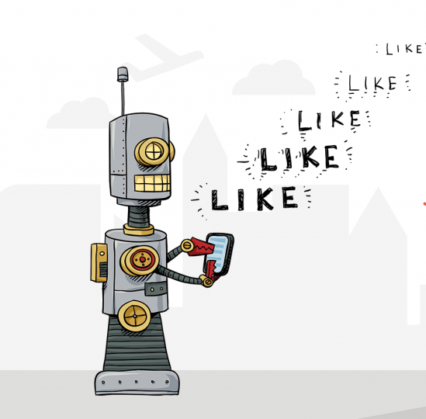
What is a social media bot?
Programs to do tasks on social media platforms
Can be good or bad with their actions
Nonetheless, raise a lot of ethical concerns

Slide 3
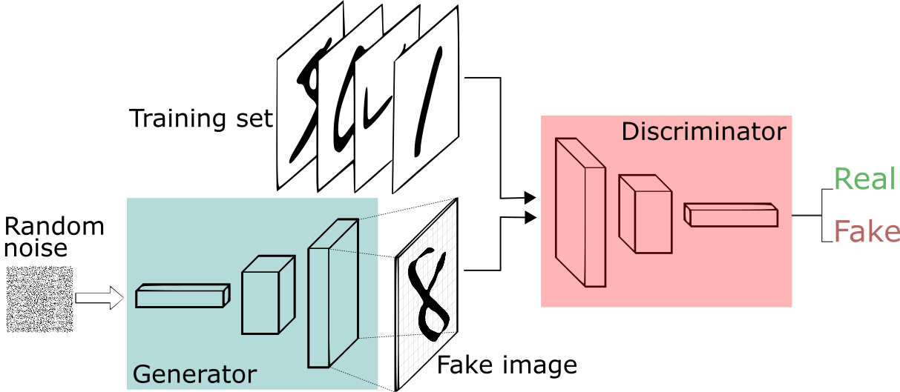
What is a GAN(Generative Adversarial network)?

Slide 4
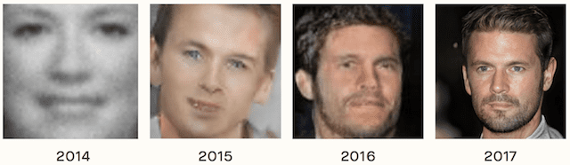
Why is a social bot with a human GAN face a problem?
Creates a lot of ethical concerns, for eg(faking a identity, manipulating people)
Harder to detect than regular bot accounts
Lately it’s been hard to differentiate between a real and a fake face

Slide 5

What have we done about this so far?
Botometer
Checks the activity of a Twitter account and gives it a score.
Higher scores mean more bot-like activity.
Considers around 1000+ features in it’s analysis.
However, doesn’t consider the profile picture in it’s analysis, yet!!

Slide 6
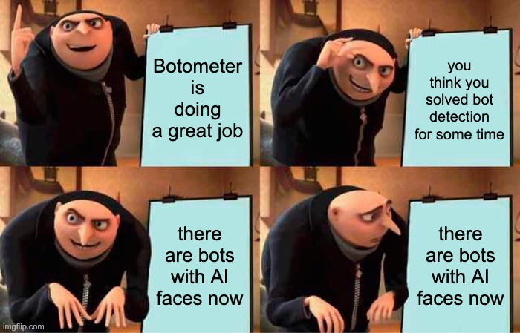
OUR PROBLEM?

Slide 7
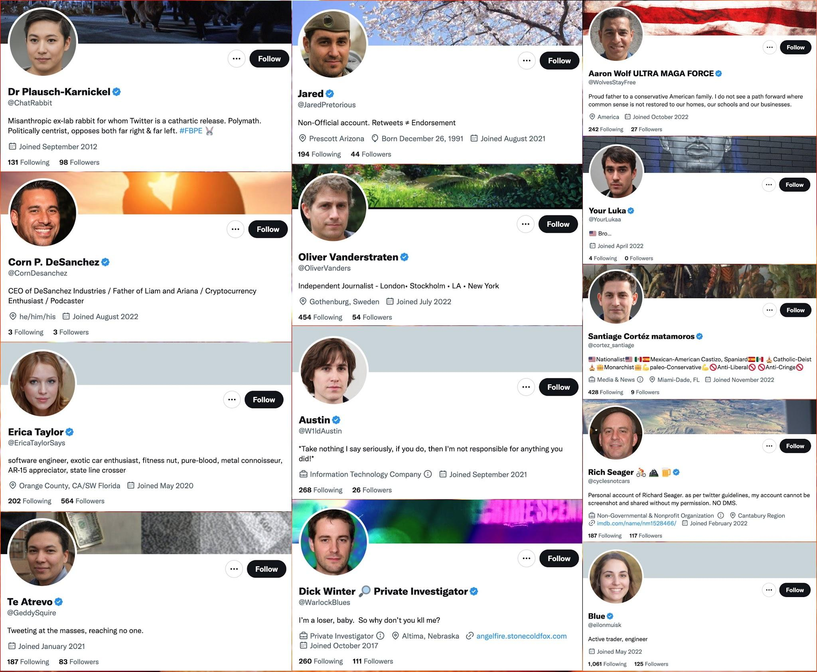
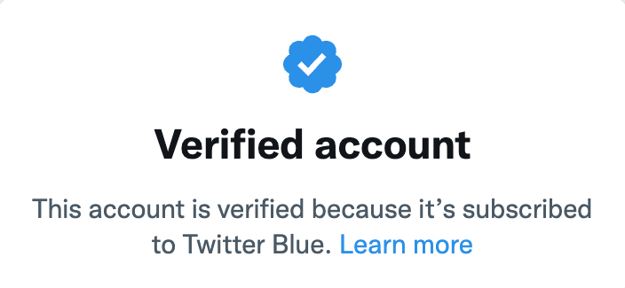
Some *verified* bot accounts with GAN faces out there

Slide 8

What are we doing about it?
Actual fake faces used on twitter by bots.

Slide 9
Data collected so far
StyleGAN dataset on GDrive.(100k+ GAN faces)
Academic dataset from generated.photos (10k GAN faces, heavily annotated)
TwitterGAN dataset(twitter accounts with GAN faces)(250+ accounts)
Tweets with profile pictures(100k+ images)

